Slide 1
Data Mining Cup 2017 Revenue Forecast of Mail Order Pharmacy
3rd intermediate presentation
Data and Web Science Group
University of Mannheim
Alexander Brinkmann, Liane Gybas, Daniel Helfer, Nancy Kunath, Florian Schrage, Timo Sturm, Steffen Terheiden, Christoph Wagner
09.05.2017

Slide 2

Overview
Selection
Preprocessing
Transformation
Data Mining
Evaluation & Interpretation
Available data
…….
Target
Data
Preprocessed Data
Transformed Data
Patterns
Adopted from Fayyad et al. (1996)

Slide 3
Preprocessing
Feature Understanding
Feature Engineering
Selection
Preprocessing
Transformation
Data Mining
Evaluation & Interpretation
Available data
…….
Target
Data
Preprocessed Data
Transformed Data
Patterns
Adopted from Fayyad et al. (1996)

Slide 4
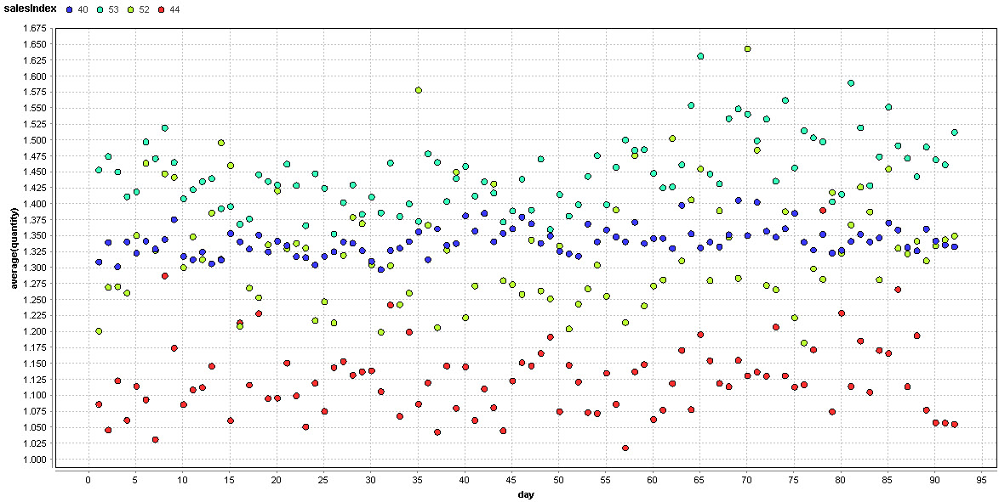
Feature Understanding
SalesIndex - Dispensing Regulation Code

Slide 5
Feature Understanding
SalesIndex - Dispensing Regulation Code
 | percentage of all products | percentage of all orders | corresponding pharmForms | Meaning
53 | 60% | 38% | bonbons, sanitary pads, tampons, lancets & needles | no restriction
40 | 35% | 57,4% | infusion materials & injection materials | prescription required
52 | 4,5% | 3,6% | 13,8% tea & 11,8% filter bags | ?
44 | 0,6% | 1% | nothing suspicious | ?
Notes:
Dispensing Regulation Code
Looking for legal regulation without success
All Generic Products 40

Slide 6
Feature Engineering
New Features:
SameProductAttributes: All products with the same product attributes
GroupSizeSameProductAttributes: How many products belong to group?
hasCompetitor: Is a competitor price available?
maxPrice: highest price over time
minPrice: lowest price over time
maxMinPriceVariance: absolute price variance per pid
maxMinPriceVarianceRatioToMaxPrice: relative price variance per pid
meanPriceVariance: How flexible is the price?
meanPriceVarianceRatio: How flexible is the price in relation to the mean price?
DayTime: When does a transaction take place during the day?
DayID: Transaction Count per Day
lineIDPerDay: Total number of line IDs per day

Slide 7
Data Mining and Evaluation
Trends
One Step Model
Two Step Model
Selection
Preprocessing
Transformation
Data Mining
Evaluation & Interpretation
Available data
…….
Target
Data
Preprocessed Data
Transformed Data
Patterns
Adopted from Fayyad et al. (1996)

Slide 8
DMC 17 - Challenge
Original task
Two step model
Adjusted two step model
Trend splitting model
Split data based on trend analysis
Predict the type of user action (Click/Basket =1 vs. Order =1)
Predict the type of user action (Click/Basket =1 vs. Order =1)
Predict the type of user action (Click/Basket =1 vs. Order =1)
Predict the revenue for every user action
Predict the quantity for all “order” actions
Predict the quantity/revenue for all “order” actions
Predict the revenue for all “order” actions
Evaluate result based on trend analysis
Regression problem
Classification problem
Trend analysis

Slide 9
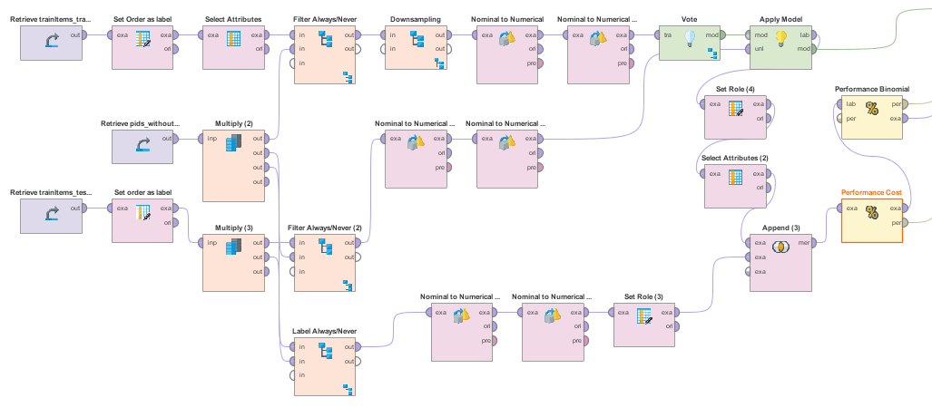
Order Classification Model
Cost based optimization, to avoid default trees
Classification Process
Cost Matrix | True 1 | True 0
Predicted 1 | 0 | 3
Predicted 0 | 2 | 0
Notes:
Cost matrix, included costs, to avoid default models for tree learners
- optimized different base learners (NB, sorts of trees, SVM, ANN)
-> feature selection
-> parameter optimization
Tried different ensemble learners (Boosting, Bagging, Stacking -> best results with voting)
It was always hard to beat the baseline
We use SVM, Naive Bayes and a Neural Network within a voting

Slide 10
Order Classification Model
Handlabeled Data
Not available products as not ordered
Transactions with availlability = 4 are 99,8% only clicked
Products always not ordered in training set as not ordered
Labels 13.000 test examples with accuracy of 93%
Improves our classification slightly
Notes:
To improve our performance we labeled some examples directly as not ordered

Slide 11
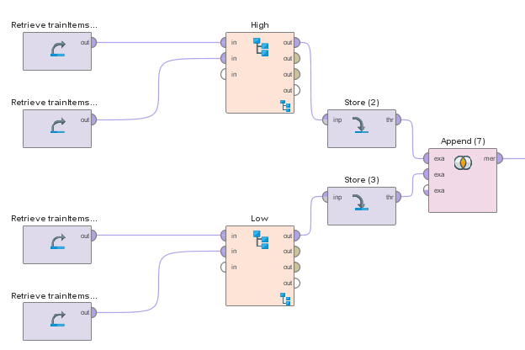
Trend Splitted Classification
Splitted training data set into days with high and low revenue
In low days 20% of transactions are orders
In high days 25% of transactions are orders
Learn indepent optimized models for different conditions
Notes:
As announced last week we want to split our data into day with high and low aggregated revenue
So learn different Models for both and optimize parameters independently of each another

Slide 12
Comparison of Classification Approaches
Performance of the classification without split
Costs = 0.688 Accuracy = 72.15%
Performance of the classification with trend split
Costs = 0.704 Accuracy = 71.82%
Notes:
Without split on the data: Costs: 0.688 Acc: 72.15%
With split on the data: Costs: 0.704 Acc: 71.82%
(High: 0.728; 71,48% and Low: 0.666 and 72,34%)
→ Very poor results in both cases ...
→ it‘s probable that we can‘t improve our regression with this results
→ the trend splitting approach seems not to be an improvement

Slide 13
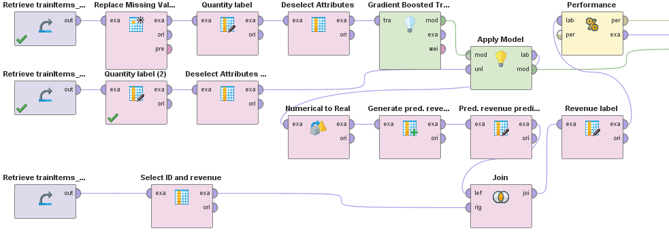
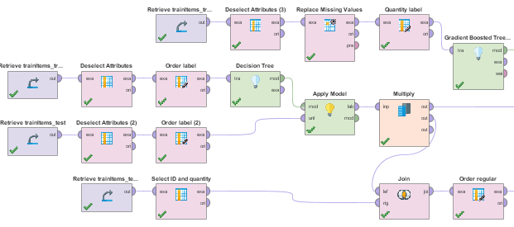
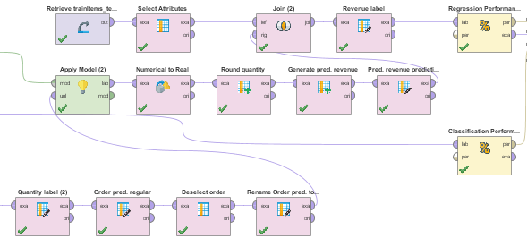
Regression Models
Performance of the One Step Model with quantity label
RMSE* = 9.658
Performance of the Two Step Model with quantity label
RMSE = 11.561
*RMSE : Root Mean Squared Error
Notes:
Conclusion, huge effort in optimization with actual features didn‘t improved our results → there are propably not more information in our data
→ We need to find better features, explaining more parts of the data

Slide 14
Relevant Features
Low Dataset
High Dataset
SVM
Regression
Feature Selection Naïve Bayes
Feature Selection Naïve Bayes
Manual Correlation Analysis
Gradient Boosted Tree
ProductOrderCount
ProductOrderRatio
PharmForm
MonthHalf
RatioPriceDifferenceToCompetitorPrice
RatioPriceDifferenceToPrice
DiscretizedUnit
Date
Day
PriceComparison
productOrderCount
RatioDifferenceRrpCompetitorPrice
Week
Weekday
ProductOrderRatio
Weekend
GenericProduct
Manufacturer
Month
Price
ProductOrderCount
ProductOrderRatio
RatioPriceDifferenceToPrice
RatioDifferenceRrpPrice
Price
MeanPrice
NormalizedPrice
Category
Manufacturer
Group
CompetitorPrice
Content
Weekday
...
Notes:
Newest features not used untill now

Slide 15
Questions?
Feel free to ask!

